Slide 1

Convolution
Coding
CT 216
LAB GROUP 5/6
GROUP NO - 3
Acknowledgement : Prof. Yash Vasavada

Slide 2

Honor Code
We declare that the work we are presenting is our own work and we have not copied the work (Matlab code, results, etc) that someone else has done. Concepts, understanding and insights we will be describing are our own. Wherever we have relied on an existing work that is not our own,we have provided a proper reference citation. We make this pledge truthfully, knowing that violation of this solemn pledge can carry grave consequences.

Slide 3





Signatures

Slide 4

What is Convolution Coding ?
Convolutional coding is a method that operates on a continuous stream of data rather than fixed-length bit blocks.
The bits of the output code are generated by performing logical operations on the current bit along with a few of the preceding bits in a given continuous data stream.
In this encoding process, data bits are given as input to a shift register, which has a length known as the constraint length denoted by K.
As a new bit is introduced into the register from the left side, it causes the existing bits to shift towards the right, with the oldest bit being removed from the register.

Slide 5
Exploring the Merits of Convolutional Coding
Error Detection and Correction Capabilities: Convolutional codes are highly effective at detecting and correcting errors that occur during data transmission. By introducing redundant bits, convolutional codes provide receivers with the ability to identify and rectify errors, ensuring reliable data delivery even in the presence of noise and interference.
Real-Time Performance: Convolutional coding allows for error correction at the receiver side without the need for retransmission. This is crucial for real-time applications, such as voice and video communications, where retransmission may not be feasible due to strict timing requirements.

Slide 6

Robustness in Noisy Environments: Convolutional codes exhibit strong performance in environments with high levels of noise and interference, such as wireless communication systems. Their ability to reliably transmit data in challenging conditions makes them well-suited for applications where the channel conditions are unpredictable or subject to significant impairments.
Widespread Adoption and Standardization: Convolutional coding is widely supported and implemented in various communication standards and protocols, such as Wi-Fi, and satellite communications. This widespread adoption and standardization facilitates the integration of convolutional coding in a wide range of communication systems and devices.

Slide 7


Basic Components
Encoder
Modulator
Channel
Demodulator
Decoder
Input
Data Stream
Output
Bits
Consisting
of K-shift
register/memory
Decoding will be
applied on
received bits
Additive White Gaussian Noise
Transmitter side
Reciever side

Slide 8
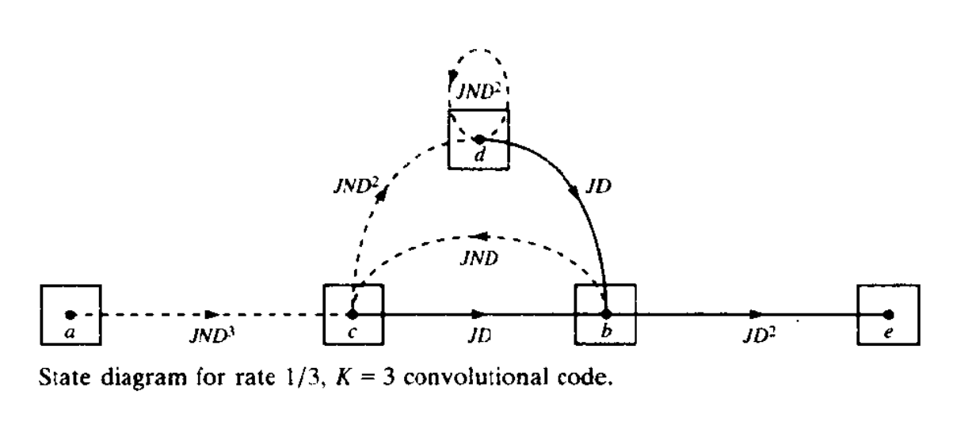
Transfer Function
A transfer function, in the context of convolutional coding, represents the relationship between the input and output of a convolutional encoder. It is commonly used to analyze the performance of convolutional codes
Exponent of J - length of the path that merges with the all zero path for the first time.
Exponent of N - no. of ones in the information sequence.
Exponent of D - distance of sequence of encoded bits from the all zero sequence.
Here, dotted line represents that input=1

Slide 9

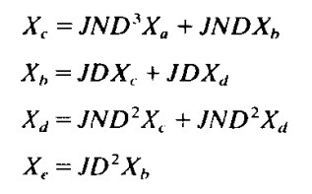
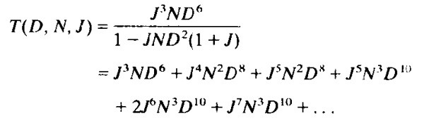
Transfer Function
To find transfer function, we need to separate the state a into two states, state ‘a’ and state ‘e’. state ‘e’ is for output and ‘a’ is for input.
Then by drawing state diagram, we will write equation for each node for every incoming branch as mentioned here.
Transfer function can be obtained by taking Xe/Xa.
In this transfer function, minimum power of D is 6. That means if the error in the sequence is less than 6 bits, than convolution decoder can detect and correct it.

Slide 10
Transfer Function
The minimum power of D is known as free distance and denoted as dfree.
i.e. if the number of errors in the received sequence is less than dfree​, the decoder can uniquely identify the transmitted codeword and correct the errors. So it characterizes the error correcting capability of a convolution code.
So, Codes with larger minimum free distances generally offer better error correction capabilities and are more robust in noisy communication channels.
Minimum non-zero exponent of D gives the minimum hamming distance. Beacuse, Exponent of D determines the distance of sequence of encoded bits from the all zero sequence.

Slide 11

ENCODING
In Convotution coding, the encoded output depends on the current state and the input given to it.
For this, the encoder uses a sliding window to calculate r > 1 parity bits by combining various subsets of bits in the window.
The combining is modulo 2 addition.
The size of the window, in bits, is called the code’s constraint length.
The greater the value of r, the higher the resilience of bit errors, but the trade-off is that a proportionally higher amount of communication bandwidth is devoted to coding overhead.

Slide 12
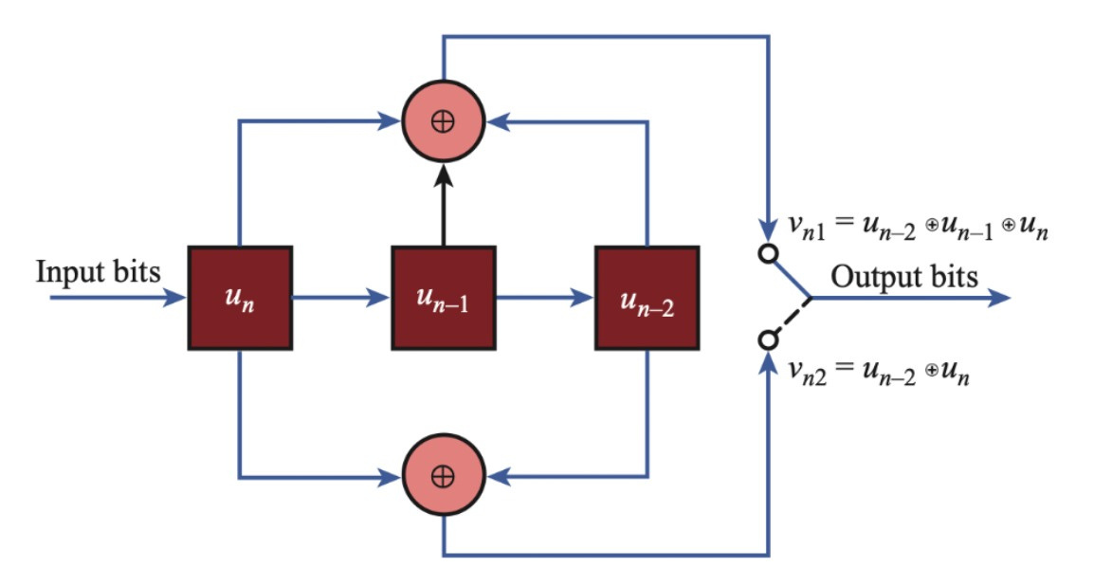

ENCODING
Here is an example of encoding
process in which r=1/2,
contraint length Kc=3
and generator matrices are
g1 = [1 1 1] , g2 = [1 0 1]

Slide 13
BPSK And AWGN Simulation
We then pass the output of the encoder to a BPSK modulator, which converts the digital signal to analog signal.
It does so by mapping digital input 0 to +1V and digital input 1 to -1V.
Equation : 1 - 2b ; b = 0 , 1
Then the BPSK symols are passed through an an AWGN channel which introduces a per-symbol SNR of ES/N0.

Slide 14
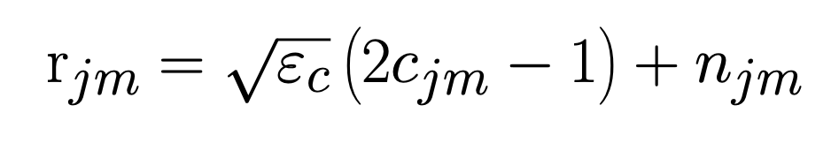

Relation Between input bit and recieved symbol
th
th
r = received (m) value at (j) branch
c = input (m) value at (j) branch
e = energy of signal , n = noise added
jm
th
th
jm
jm

Slide 15
DEMODULATION HARD DECODING
It is a method for decoding the encoded analog symbols.
It involves making a binary decision for each received symbol, determining it as either '0' or '1'. This decision is based on comparing the received symbol to a certain threshold.
Because of this, some information is lost.
DEMODULATION SOFT decoding
In soft decision decoding the received symbols are fed into the decoder as it is without demodulating them into binary values.
Because of this, no information loss takes place and soft decision decoding performs better than hard decision decoding

Slide 16
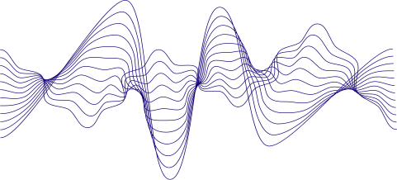
EXAMPLE
Suppose there are two symbols with probability of being 1 0.50001 and 0.99999 respectively.
The hard decision decoder will take both symbols as 1 without any difference between them.
The soft decision decoder will send the symbols as it is and thus preserve the information that the first symbol is less likely to be 1 than the second one.

Slide 17
DECODING:
TRELLIS DIAGRAM
In the decoding part of convolution code, sequence’s length is not fixed. So we use finite state machine, in which we have state diagram showing the input-output relationship for all the states.
By using state diagram, we create a Trellis diagram of length = sequence length + zeros of length Kc (to ensure that initial and final state is same i.e. all zeros state)
This Trellis diagram is used in the decoding of the convolution code.

Slide 18

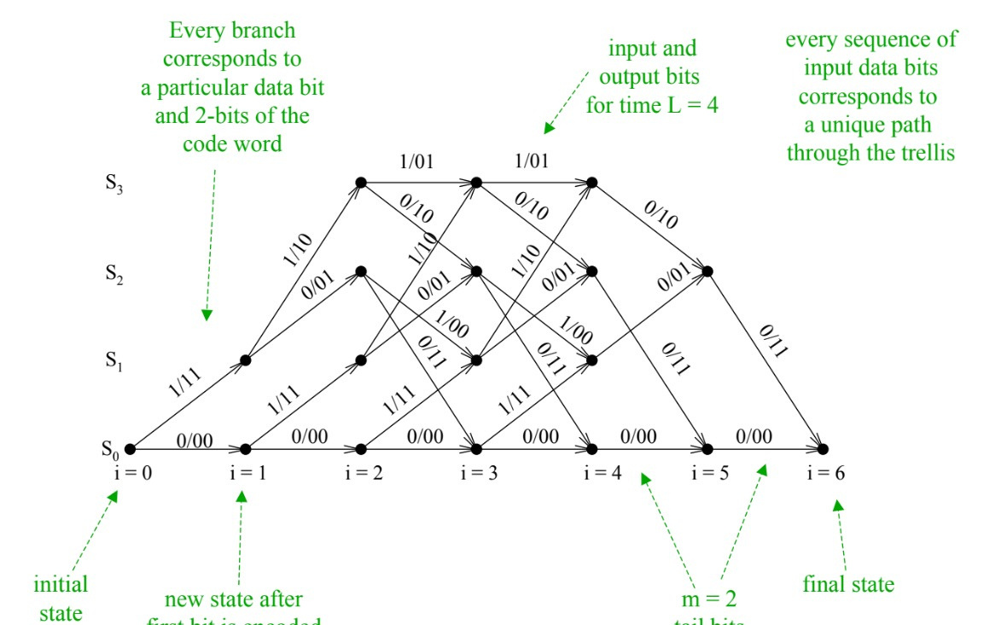
DECODING:
TRELLIS DIAGRAM
This is the Trellis diagram for length=6 (received sequence length=4 and 2 bits are tail bits to ensure it reaches the final state as S (00 state).
This Trellis can be used in Viterbi Algorithm to decode the encoded sequence.
o

Slide 19
DECODING:
VITERBI ALGORITHM
Viterbi algorithm is used in the decoding process of convolution code.
It uses Trellis diagram to decode the orginal sequence.
In which we calculate branch metric for every branch and path metric for every path.
In both hard and soft decision decoding, metrics are calculated differently.

Slide 20
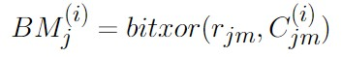
Branch Metric For Hard Decoding
For Hard decoding, the branch metric is chosen as the hamming distance between the expected codeword and the recieved codeward.
That is, the number of places the expected codeword and the recieved codeword have different Bits.
For example, the hamming distance between the codewords 110 and 101 is 2, because the bits differ at 2nd and 3rd bits.

Slide 21

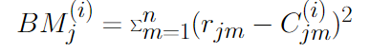
Euclidean Branch Metric for Soft Decoding
For soft decoding, A branch metric which can be chosen is the Euclidean distance between the expected codeword and the recieved codeward.
That is, the square of the difference between the expected codeword and the recieved codeword. Note that the recieved codeword can be a real Number, unlike in hard decision in which only digital values are allowed.
For example, If the expected codeword is 10 and the recived codeword is (-0.5,0.5), the distance between them will be (-1+0.5)^2+(1-0.5)^2=0.5.

Slide 22
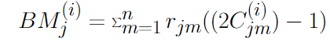
Non Euclidean Branch Metric for Soft Decoding
Other non euclidean branch metric can also be chosen for soft decision decoding.
One such non euclidean branch metric we have chosen is product of recieved codeword and expected codeword in analog form.
For example, If the expected codeword is 10 and the recived codeword is (-0.5,0.5), the expected codeword in analog would have been (-1,1). thus the branch metric would have been -1*-0.5+1*0.5=1.

Slide 23
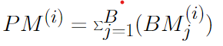
PATH METRIC
The path metric is the sum of all the branch metrics in the path.
The calculation of the path metric is the same for both hard decision decoding and soft decision decoding.
In both hard and soft decision decoding, we we will choose the path having minimum Hamming/Euclidean distances. i.e. Metric which is giving most appropriate path.

Slide 24
DECODING:
VITERBI ALGORITHM
We calculate path metrics for each path, which merge at each node
There are 2 metrics computed for each node. (because, 2 paths merge at each node)
Of 2 paths that merge at each node, only one survives, and this is the, most probable path (minimum hamming/Euclidean distance).
All other paths are eliminated and the metric for that given node is branch metric of that branch + path metric till previous node.
k
k
k

Slide 25
Calculating Bit Error Rate
For calculating the bit error rate for a specific SNR value, we run the simulation a certain number of times, and compare the original keyword to the decoded keyword.
We count the number of bits flipped in the decoded keyword for each simulation and add them up.
We then divide this sum by the number of simulations as well as the length of the keyword to recieve the bit error rate.

Slide 26
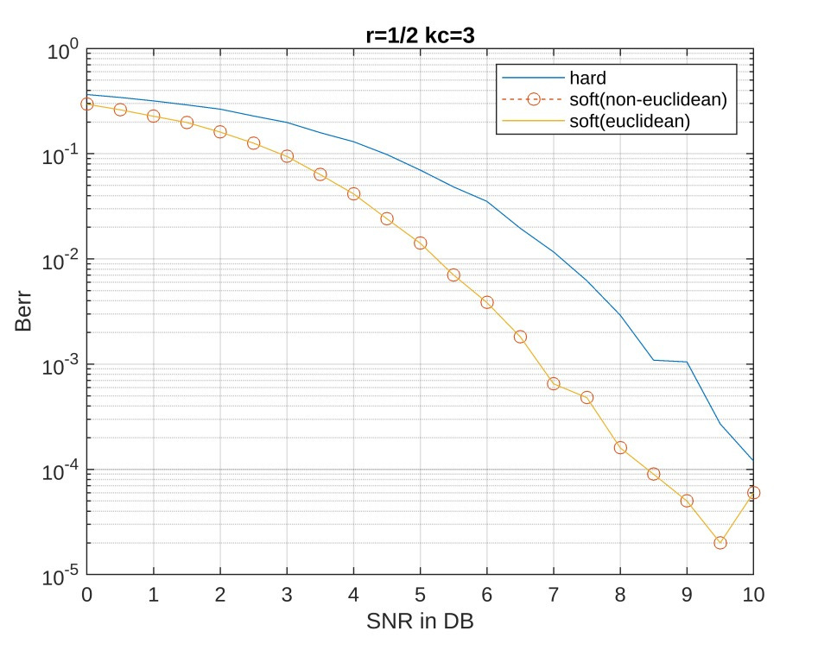
PERFORMANCE ANALYSIS
Here is the graph for rate=1/2 and Kc=3
convolution code
Conclusion:
-> We can observe that soft decision
decoding is performing better than
hard decision decoding at any
given SNR
-> As SNR increases, BER decreases.

Slide 27
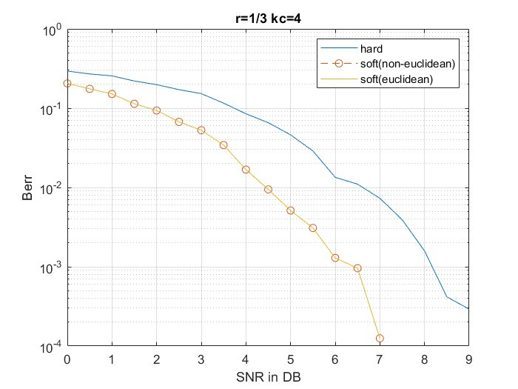
PERFORMANCE ANALYSIS
Here is the graph for rate=1/3 and Kc=4
convolution code
Conclusion:
-> We can observe that soft decision
decoding is performing better than
hard decision decoding at any
given SNR
-> As SNR increases, BER decreases.

Slide 28
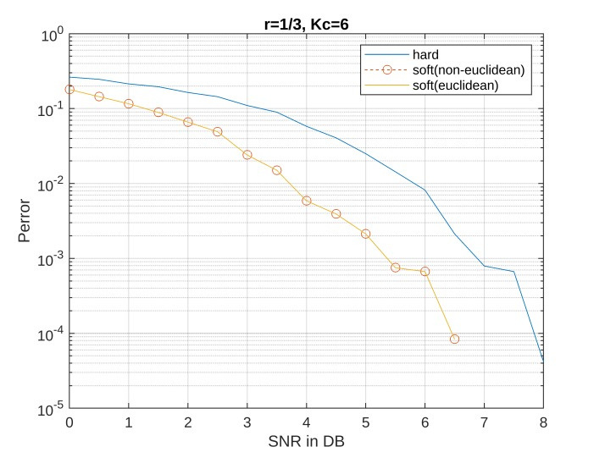
PERFORMANCE ANALYSIS
Here is the graph for rate=1/3 and Kc=6
convolution code
Conclusion:
-> We can observe that soft decision
decoding is performing better than
hard decision decoding at any
given SNR
-> As SNR increases, BER decreases.

Slide 29
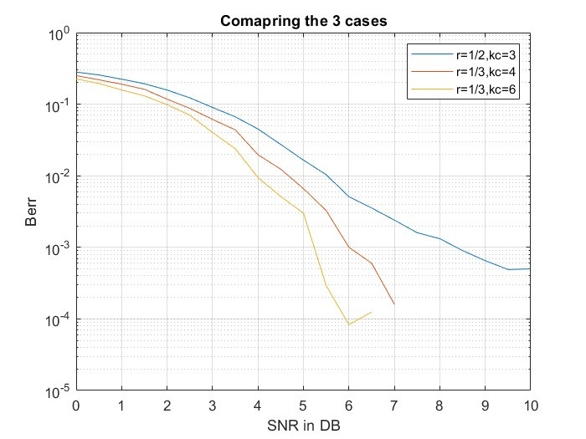
PERFORMANCE ANALYSIS
The graph beside shows the comparison of BER for all of the three cases i.e. r=1/2, Kc=3 , r=1/3, Kc=4 and r=1/3 and Kc=6.
We can observe that BER for lower rate(r=1/3) code is low compared to high rate(r=1/2) codes.
If rate for the codes are same, then the BER is less for the code whose Kc is high
Comparison of all the three cases in soft decision decoding

Slide 30
PERFORMANCE ANALYSIS
Here, we can observe that, in all the three cases, both Euclidian and Non-Euclidean Metrics give exact same BER. i.e.Both are overlapping.

Slide 31
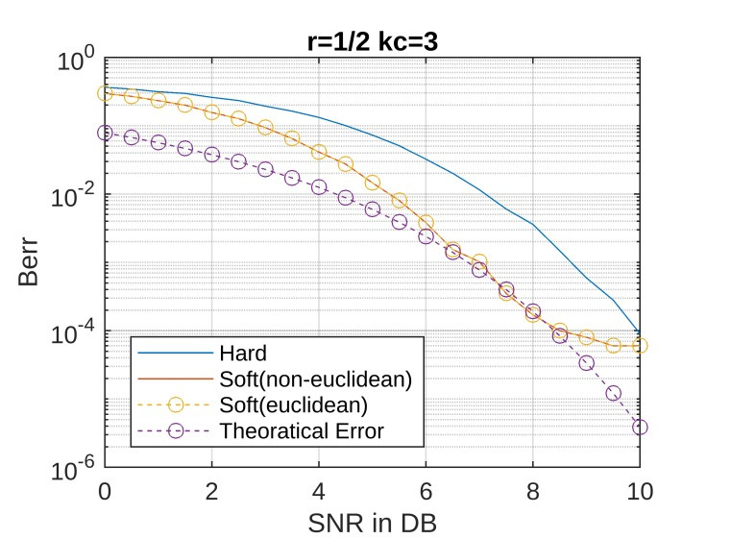
PERFORMANCE
ANALYSIS
On comparing the graphs of the analysis
plot and the real graph, we can see that on average, the plot of soft and analytics runs similarly for nearly all SNR values, but the plot of hard and analytics has some significant deviations

Slide 32
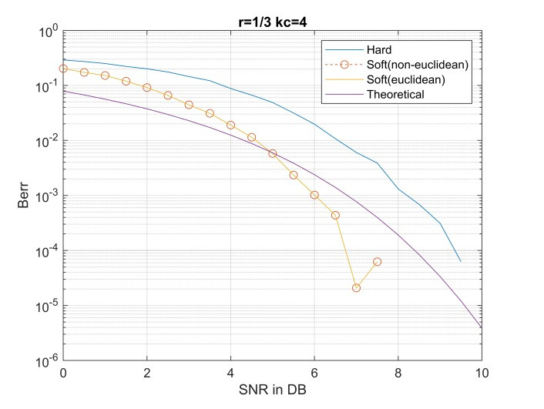
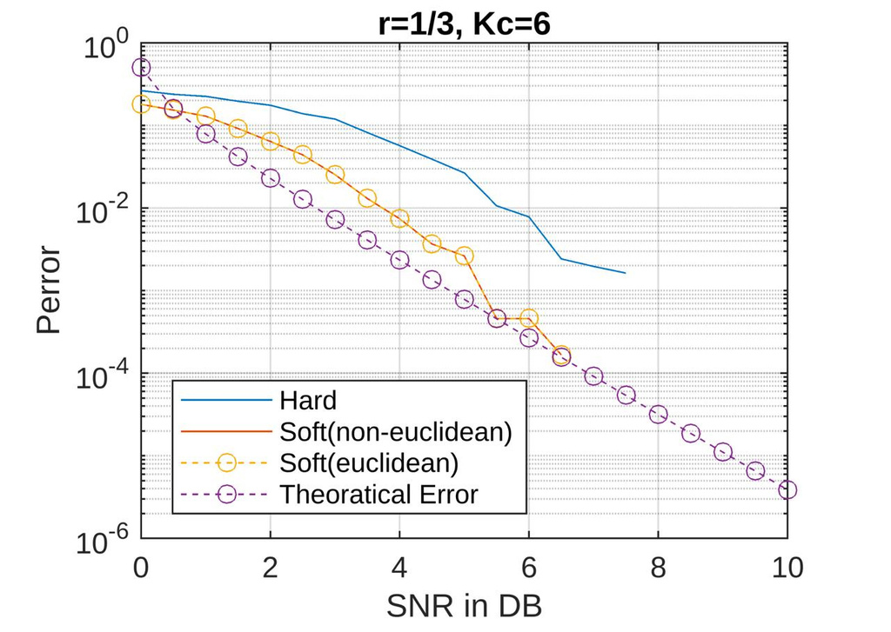
PERFORMANCE
ANALYSIS

Slide 33
Web App for Visualisation of State Diagram
We have created a web application for visual plotting of the state diagram for any given convolution coding scheme.
In Backend, we used Javascript for implementing the logic of output bits as well as target node allocation. For frontend, we have used NextJS framework and d3.js library to help with visual plotting of the diagram.
Link: https://convolution-state-diagram.vercel.app/

Slide 34
Key takeaways from project
Understand how convolutional code works and their importance in the industry.
How to compute and choose branch and path metric such as to maximise the probability of correct decoding for each case.
See the difference between hard decision decoding and soft decision decoding as well as understood why soft decision decoding works better than hard decision decoding.

Slide 35
BIBLIOGRAPHY
Photo of encoding is taken from - tpsearchtool.com
Trellis diagram is taken from - Matthew Valenti and Bibin Baby John. Introduction to Communication Systems: A Lecture on Convolution Coding and Viterbi Decoding. DA-IICT, Winter 2024.
Formulas’ of metrics is taken from - J. G. Proakis. Digital Communications. McGraw-Hill, 4th edition, 1995.

Slide 36
Members
Munjapara Dharmil - 202201440
Het Panchotiya - 202201441
Vardhman Mehta - 202201444
Stuti Pandya - 202201439
Shreya Patel - 202201460
Manav Parekh - 202201456
Aditya Raina - 202201466
Kevin Shingala - 202201465
Mayank parmar - 202201464
Alin Kansagra - 202201459
Abhishek Abbi - 202201438
abcd

Slide 37
THANK YOU!

